Slide 1

JUSTICE PROJECT PAKISTAN
REPRESENTING
THE MOST VULNERABLE PRISONERS
FACING THE HARSHEST PUNISHMENTS

Slide 2
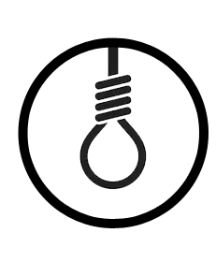



WHO DO WE REPRESENT
The Justice Project Society, commonly referred to as Justice Project Pakistan (JPP), represents the most vulnerable Pakistani prisoners facing the harshest punishments at home and abroad,
including those facing the death penalty, mentally ill prisoners,
victims of police torture, and overseas Pakistani prisoners.
DEATH PENALTY
MENTALLY ILL PRISONERS
POLICE TORTURE VICTIMS
OVERSEAS PAKISTANI PRISONERS

Slide 3

OUR APPROACH
LITIGATE
COMMUNICATE
ADVOCATE
Led by lawyers and investigators, our legal team carries out strategic litigation pursuing cases on behalf of individuals with the potential to bring systemic change
  Our communications team devises rigorous media campaigns and public events directed towards changing the public perception about the death penalty
Fierce domestic and international advocacy campaigns with the potential to bring systemic change are carried out by our advocacy team

Slide 4
Problems we see
One of the largest reported death rows in the world
PAKISTAN’S CURRENT DEATH ROW POPULATION
Wrongful convictions and executions:
4,688
— Juveniles
— Mentally Ill
— Police Torture
Systemic issues in the legal system leading to miscarriages of justice
500
— Use Of Torture, Illegal Detentions
PEOPLE EXECUTED IN PAKISTAN SINCE DECEMBER 2014
— Inadequate Assistance Of Counsel
— No Sentencing/Mitigation Guidelines
— Post-conviction Reviews Seldom Reviewed By The Supreme Court

Slide 5
‘COUNTING THE CONDEMNED’
JPP’s Yearly Data Analysis of Pakistan’s Use of the Death Penalty
Since 2004, Pakistan has sentenced almost one person a day to death
EVERY
Pakistan’s use of the death penalty is among the harshest in the world, accounting for 26% of the world’s death row, 13% of global executions, 14% of worldwide death sentences
7th PERSON
SENTENCED TO DEATH
IN THE WORLD IS A
PAKISTANI
Since 2014, the Supreme Court of Pakistan has overturned
85% of death sentences on the basis of flawed investigations and
mistrials reducing the death row population significantly
EVERY
A person has to spend on average 11 years on death row
before execution or acquittal.
8th PERSON
EXECUTED IN THE
WORLD IS A
PAKISTANI

Slide 6
INTERNATIONAL OBLIGATIONS
  Pakistan has signed 7 of the 9 core UN HR treaties and is reviewed by the Treaty Bodies
  Under Article 6(2) of the International Covenant on Civil and Political Rights, a “sentence of death may be imposed only for the most serious crimes”.
  The UN Human Rights Committee in its review of the Initial Report of the Government of Pakistan asked it to ensure that:
“The death penalty is provided only for the “ most serious crimes ” involving intentional killing; it is never mandatory; pardon or commutation of the sentence is available in all cases, regardless of the crime committed; and it is never imposed in violation of the Covenant, including in the absence of fair trial procedures…….”” (para 18(a)
UN Committee on the Rights of the Child
March 2016
Human Rights Committee
July 2017
Universal Periodic Review
November 2017
Review of the EU GSP+ Mechanism
February 2017

Slide 7
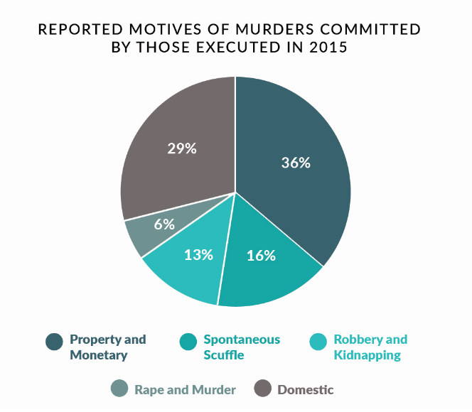
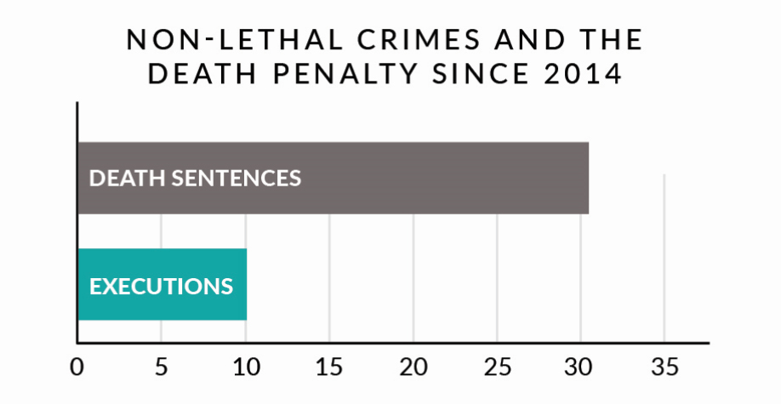
WHO ARE WE EXECUTING?
While a majority of Pakistan's death row comprises of people accused of murder and related crimes,
An analysis of 150 executions from 2015 indicates that civil disputes are a dominant
factor leading to homicides in Pakistan
Pakistan continues to sentence and execute people for crimes that do not cause death

Slide 8
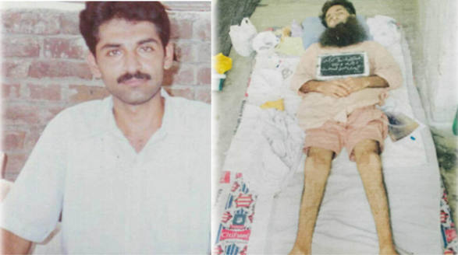
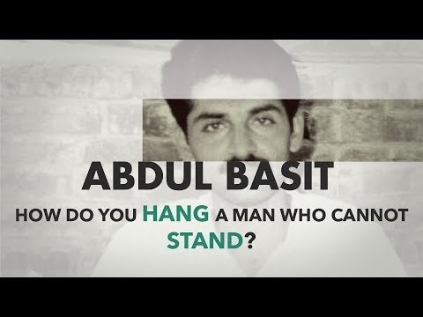
ABDUL BASIT
A PARAPLEGIC ON DEATH ROW
Convicted and sentenced to death in 2009
Developed tuberculosis meningitis (TB) in the ‘punishment ward’ in Faisalabad Central Jail in 2010, and became paralysed due to inadequate medical attention
Pakistan’s Prison Rules provide no provision for the execution of a man unable to stand
Execution has been scheduled and stayed three times since 2015
Currently on a stay which could be revoked at will

Slide 9
MENTALLY ILL
As per Chapter 34 CrPC, a mentally ill accused at trial stage, should be referred by the Judge to the Medical Board for mental health assessment.
  There is no set procedure for the Medical Board to follow. Assessments are often brief and rely only on a 5 minute consultation with the accused. Records, past history and interviews with family members are not considered. Therefore medical health assessment reports are very limited in content;
  Judges are very concerned regarding ‘opening floodgates’. There is no test to detect whether the accused is malingering.
Chapter 18 of the Pakistan Prison Rules 1978, outlines the procedure for treatment of prisoners suspected of having mental illness. Rule 444 Procedure in case of a convicted prisoner of unsound mind --- Whenever it appears to the Superintendent that any convicted prisoner is of unsound mind, he shall, in the first instance, place the patient under the observation of Medical Officer for a period of ten days. After the expiry of this period, the Medical Officer shall report the result to the Superintendent. If the patient is found to be of unsound mind, a report regarding his case shall be submitted to the Inspector-General for obtaining the orders of the Government for his removal to a mental hospital.
Both the trial and prison procedures are founded on the basis that the mental illness is temporary. Once treatment is administered, the accused can then resume their trial or return to death row and be executed.

Slide 10
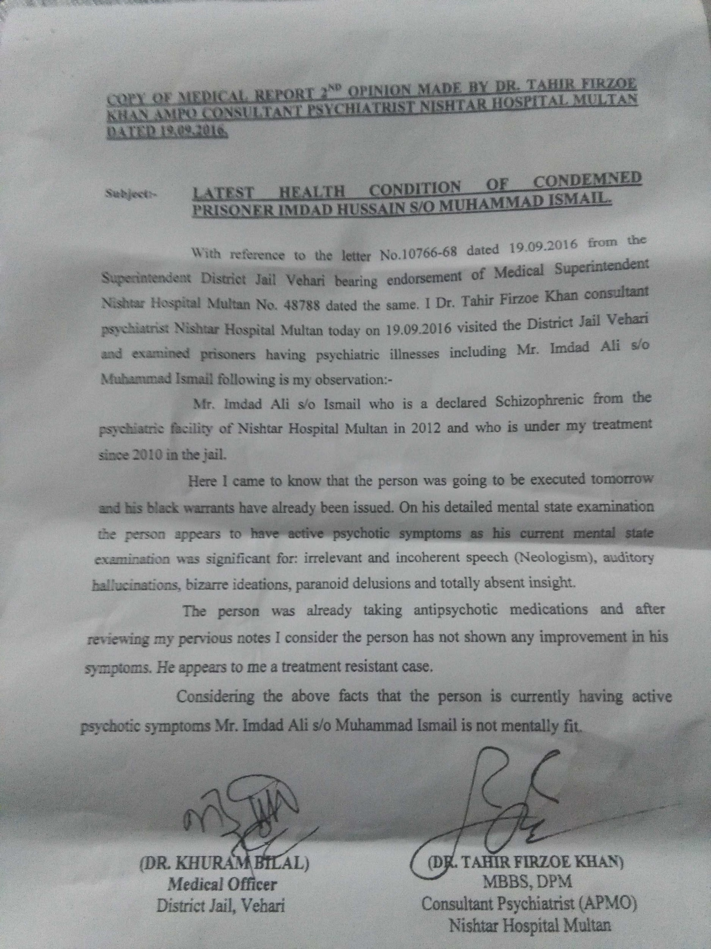
IMDAD ALI – A BREAKTHROUGH CASE
JPP Investigated and litigated in the following:
Trial Court: 2002
High Court: 2008
Supreme Court: 2015
Imdad’s case came into the limelight in 2016 when the Supreme Court dismissed his appeal stating that “schizophrenia is a curable disease” and not a mental illness.
Imdad has a history of mental illness from childhood.
His jail medical record reveals that he is suffering from psychotic symptoms later diagnosed as paranoid schizophrenia. “He had no insight into his illness” – Head of Department of Psychiatry, Nishter Hospital Multan
Execution stayed by the SC on grounds of mental illness, ordered a special Med Board to evaluate him
ALTERED
BEHAVIOUR
PERSECUTORY DELUSIONS
AUDITORY HALLUCINATIONS
NEWLY COINED WORDS,
SUSPICIOUSNESS

Slide 11
JUVENILES
1) What is best practice regarding age determination protocols? Protocol is set out in legislation (Juvenile Justice System Act 2018), but practically not enforced.
2) How to ensure that juveniles who are imprisoned are appropriately detained? The Prison Rules (1978) set out procedures (eg. Where possible, juveniles should be imprisoned in a separate juvenile jail – in practice, this does not happen)

Slide 12
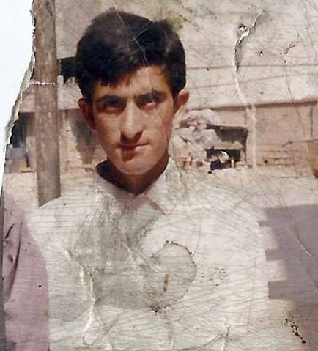
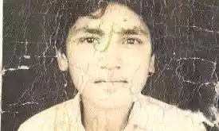

DEATH ROW’S CHILDREN
At least 6 juvenile offenders executed despite legal prohibition
Over 100’s of those on death row sentenced for crimes committed as children
Less than 34% births registered and over 46% households have no form of registration
Ansar Iqbal: Police rely upon arbitrary visual assessments to determine age
In the absence of age determination protocols, courts dismiss government issued records proving age.
Juvenile Justice Systems Bill, 2018

Slide 13
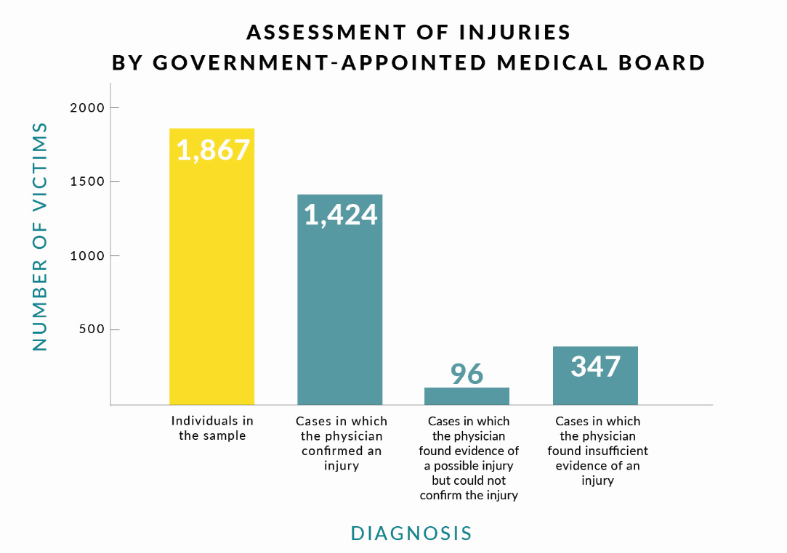
‘POLICING AS TORTURE’
Torture by police is used with impunity to extract confessions/statements which leads to death sentences
Marginalized groups including indigents, women and children are most vulnerable
Lack of criminalization of torture and an independent investigation mechanism
Government produced only 14 cases where action was taken against perpetrators during the UN CAT review
Policing as Torture in Faisalabad: A total of 1,424 confirmed cases of abuse out of a sample of 1,867 Medico-Legal Certificates produced in one district between 2012 – 2014. 58 of the victims were children and 134 were women.

Slide 14
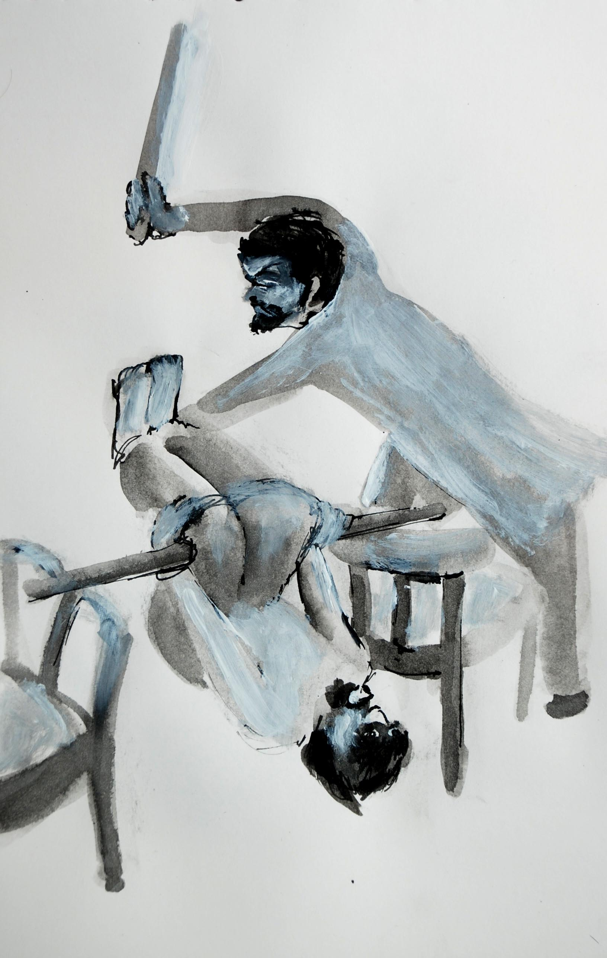
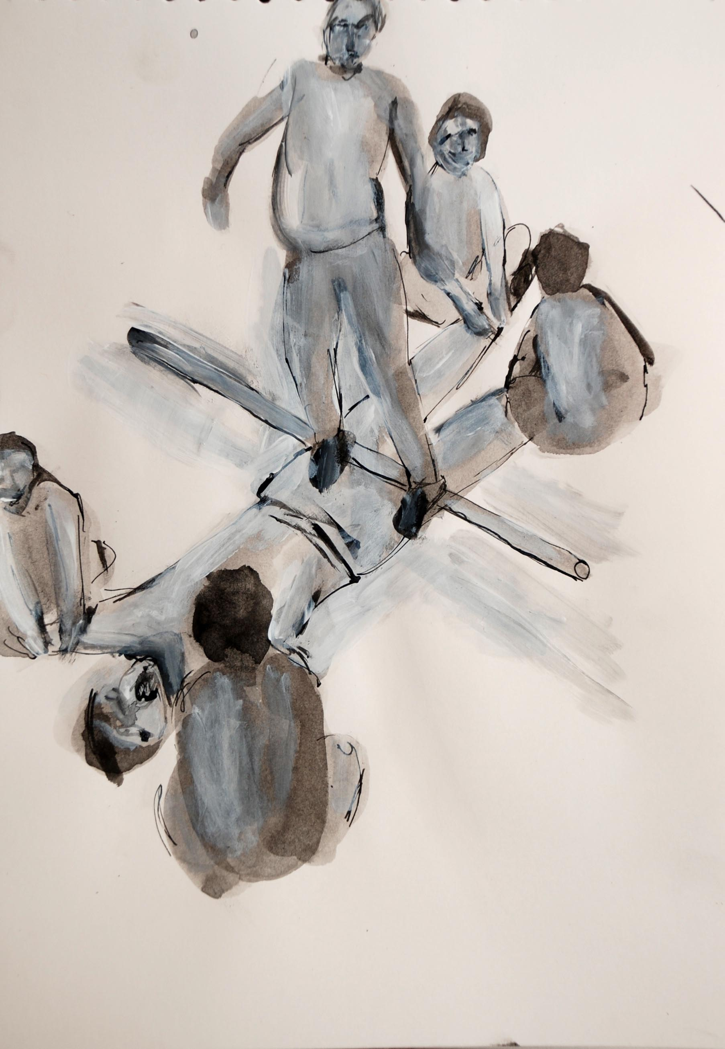
“
Police tortured me to try and make me confess. I was hung by my hands, beaten repeatedly with batons, punched, slapped and kicked. They held a gun to my head and said they would kill me if I did not confess. I was 17 years old at the time.”
– A juvenile victim of torture executed on 31 March 2015

Slide 15
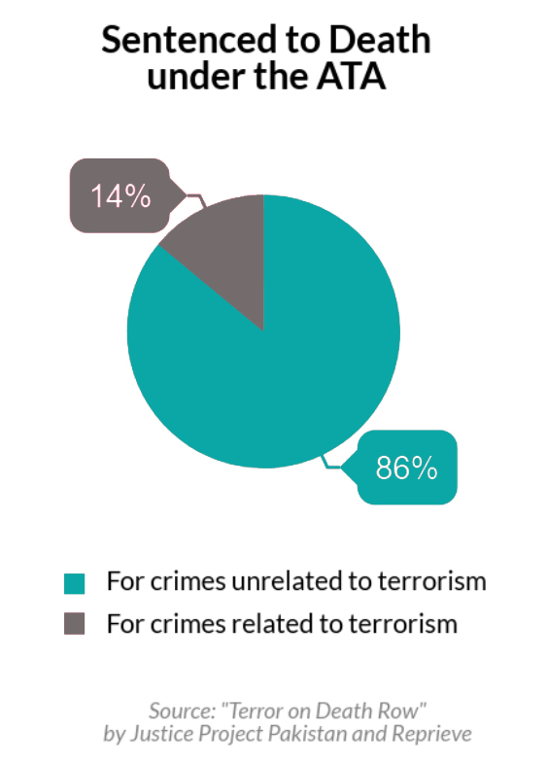
TERROR ON DEATH ROW
Anti-Terrorism Act, 1997 (ATA) defines terrorism in a broad and vague manner
86% of all death sentences under ATA are for crimes bearing no nexus to terrorism
Overburdening of Anti-Terrorism Courts and high rates of acquittals
Weakened procedural safeguards – admissibility of confessions in police custody and expedited trials.
High incidence of police torture and abuse (For e.g. Shafqat Hussain)
Lack of protections for vulnerable groups (For e.g. Muhammad Iqbal)

Slide 16
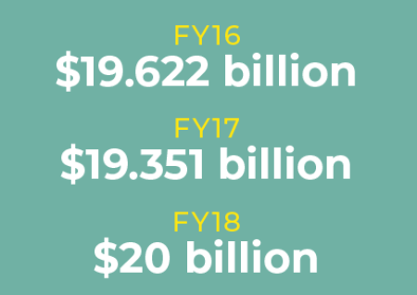
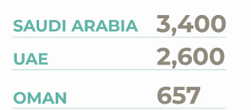
PAKISTANI MIGRANTS ABROAD
10 million
PAKISTANI CITIZENS ARE LIVING OVERSEAS
11,000
PAKISTANI CITIZENS ARE LANGUISHING IN JAILS
ACROSS THE WORLD
96% OF THEM ARE IN SIX GULF COUNTRIES
PAKISTANIS IMPRISONED IN
GCC COUNTRIES
REMITTANCES SENT BY PAKISTANI MIGRANT WORKERS

Slide 17
OPPORTUNITIES FOR CHANGE
We want to establish a justice system where human rights are inviolable
What would such a system look like?
Change in key laws and policies
  Public understands why human rights must come first, so that they: 1) consider it a priority and vote based on it; 2) remain supportive even in the face of particularly grisly crimes
  A legal field is capable of operating effectively within this system and using it improve outcomes for defendants (e.g. lawyers know how to use these precedents)
  Change in key precedents

Slide 18
OUR METHODOLOGY
Our methodology combines
INVESTIGATION, LEGAL ACTION,
PUBLIC POLICY ADVOCACY and
CAPACITY BUILDING STAKEHOLDERS.
This combined approach educates and informs both civil society and policymakers to generate effective legislative and policy reform of Pakistan’s criminal justice system.

Slide 19
OUR GOALS
Reducing the Scope of the Death Penalty to “most serious crimes”
Criminalization of Police Torture and establishment of an independent investigation mechanism
Implementation of age determination protocols for juvenile offenders
Prohibition of executions of mentally ill prisoners
Restricting the scope of the definition of terrorism under the Anti-Terrorism Act, 1997
Transparent and effective consideration of mercy petitions
Reinstatement of the moratorium on the death penalty

Slide 20
www.jpp.org.pk
facebook.com/JusticeProjectPakistan/
twitter.com/JusticeProject_

